Slide 1

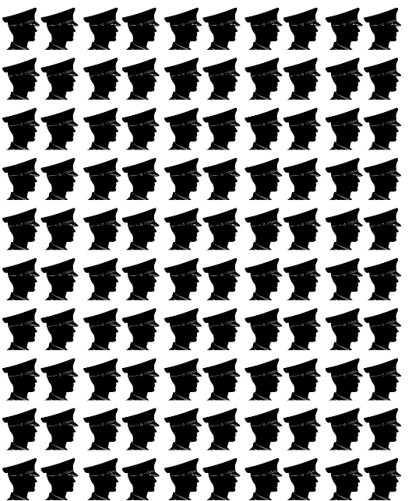

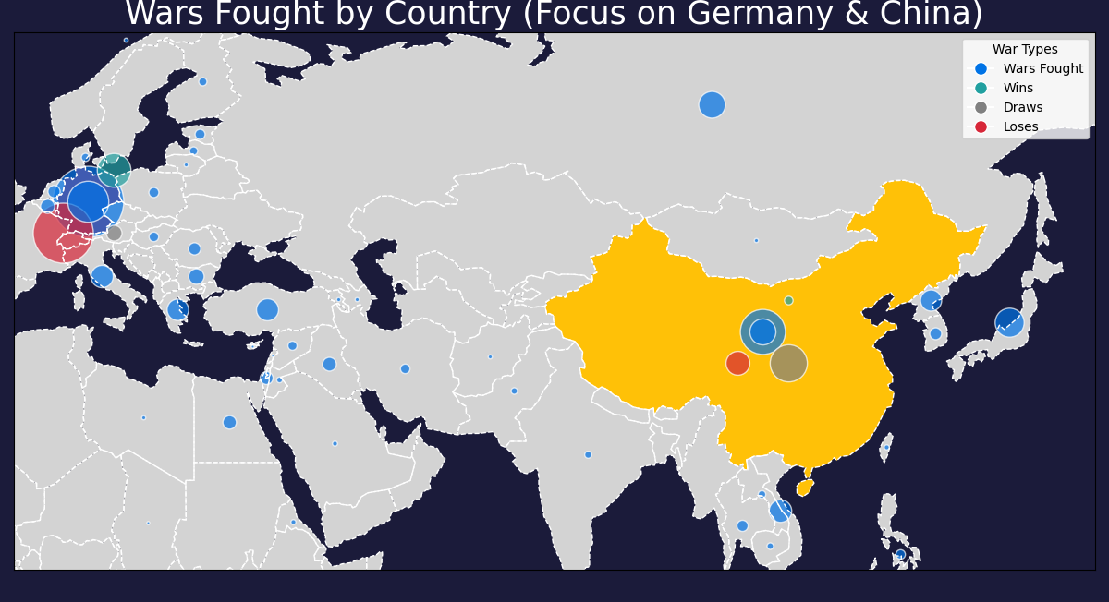
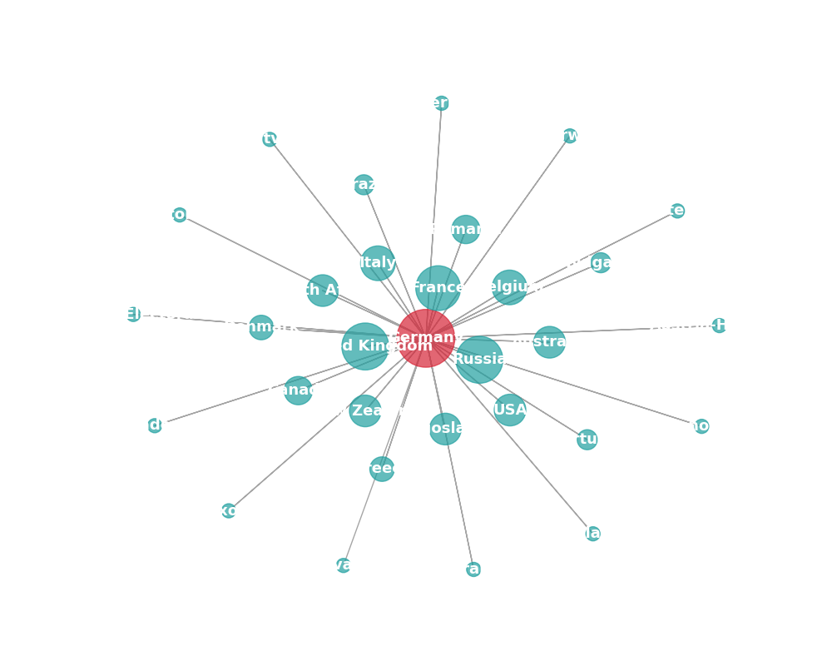
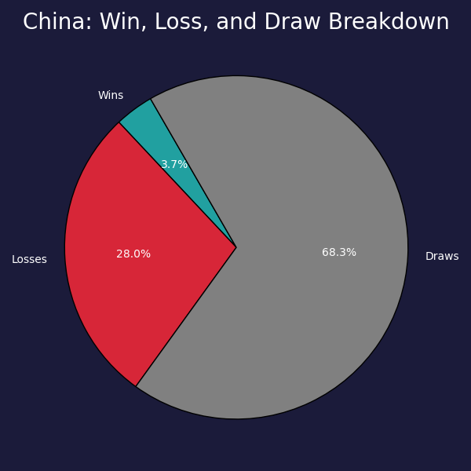
Correlates of war (COW) Dataset Germany fights a lot
China Losses a lot
Definition of a War
100
v
1
10
1
100
10
100 Deaths per side
1000 committed troops per side.
v
v
Germanies top foes are a result of , World War 1 and World War 2.
Historians Call this time in China’s history the
Century of Humiliation.
v
Definition of a war
June 12th, 1941
August 18th,1941
January 27th,1944
December 20th,1945
Hass
gary
Declaration of War
First Conflict
Last Conflict
Truce

